Slide 1
Electronics
Principles & Applications
Seventh Edition
Charles A. Schuler
Breadboarding
©2008 The McGraw-Hill Companies, Inc. All rights reserved.

Slide 2

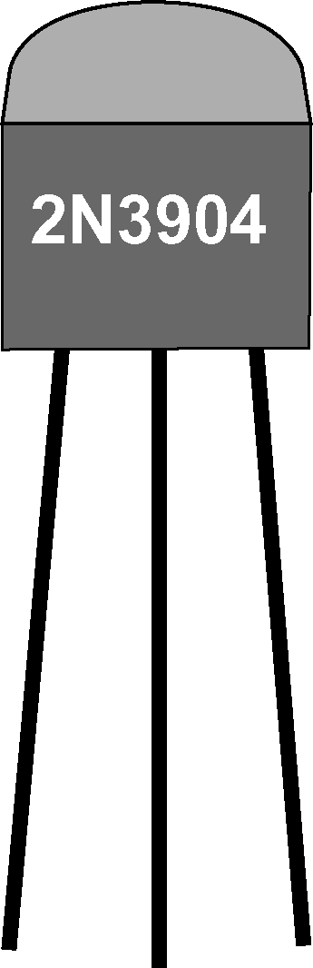
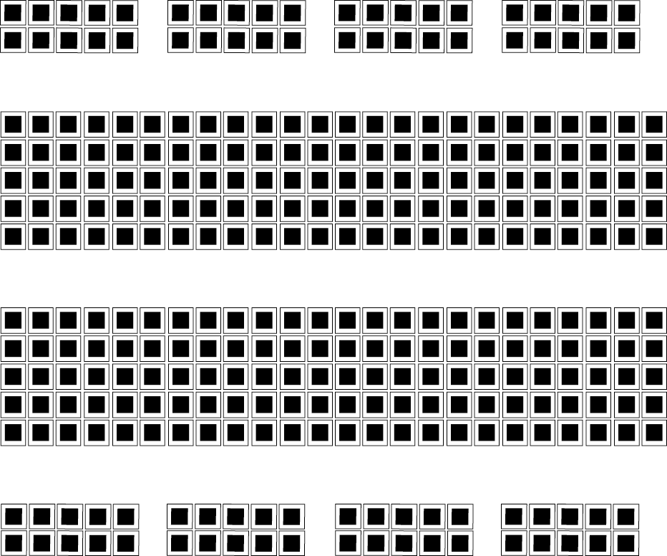
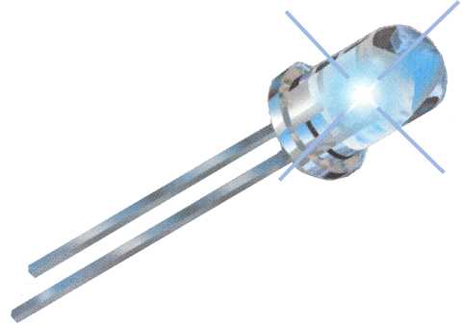


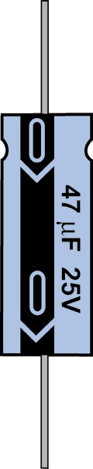
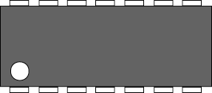
Four separate buses and 48 separate groups of 5 are shown here.
Buses
Groups of 5
Groups of 5
Many components have
compatible leads.
Buses
Strip #22 solid wire 1/4 inch
to 3/8 inch on each end.

Slide 3
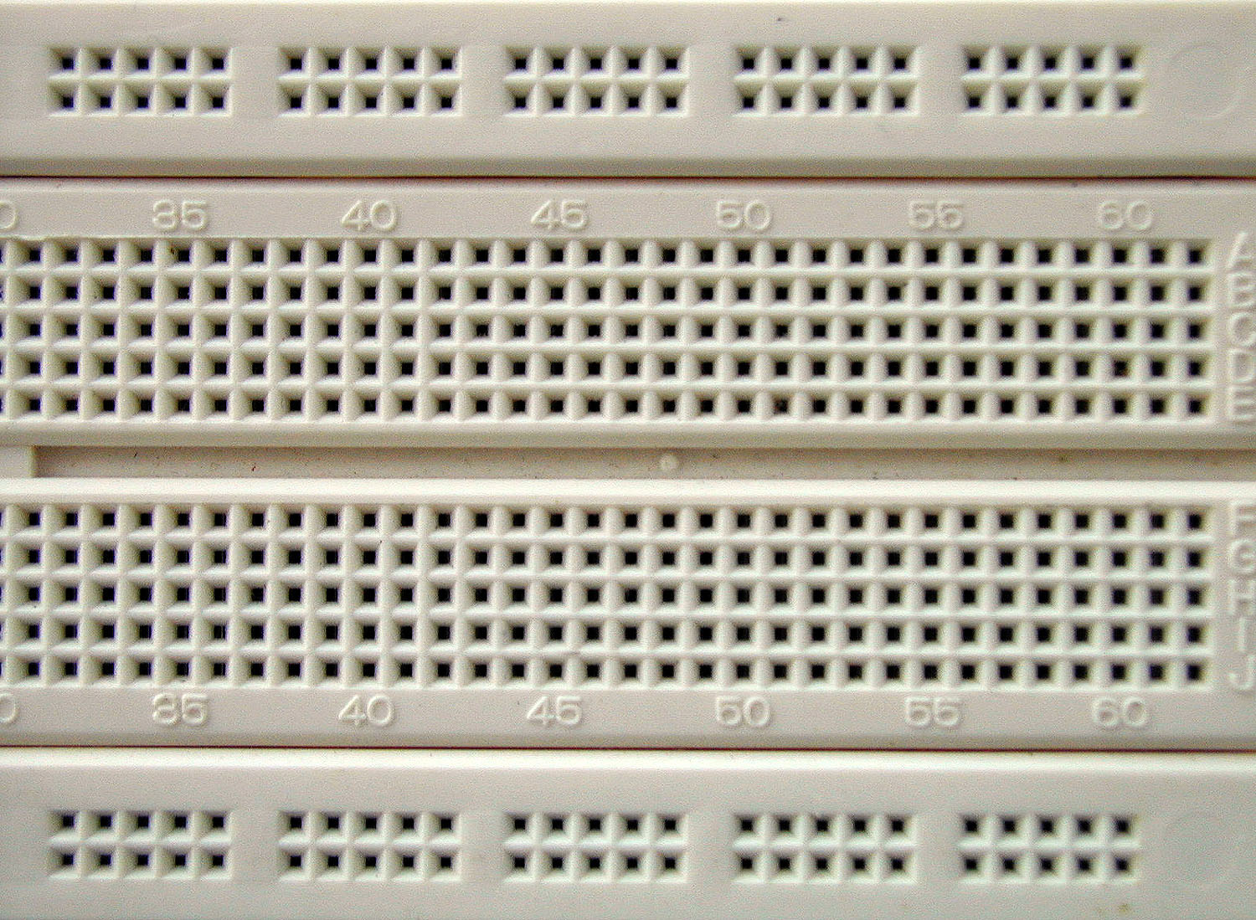
The front side of a breadboard
Buses
Group
of 5
©2008 The McGraw-Hill Companies, Inc. All rights reserved.

Slide 4
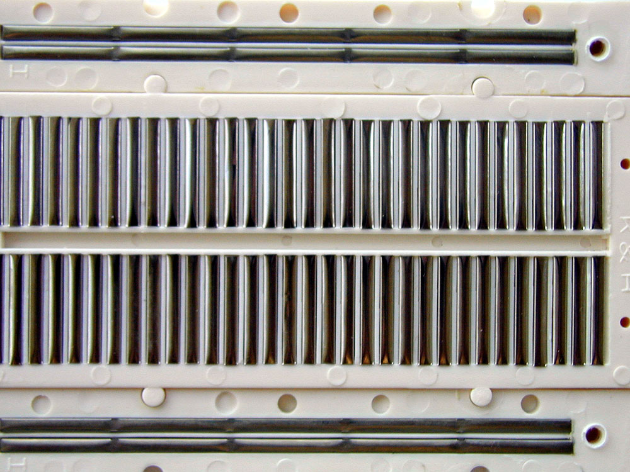
The back side of a breadboard
Metal strips
Metal strips
©2008 The McGraw-Hill Companies, Inc. All rights reserved.

Slide 5
How the groups and buses work
Continuity
No continuity
Continuity
No continuity
No continuity

Slide 6
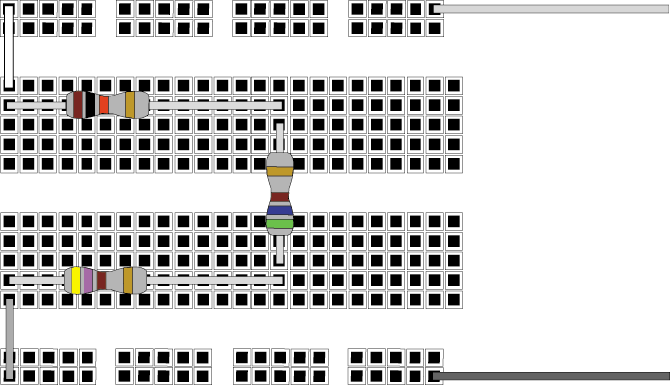
Series circuit
+
+
1 kΩ
560 Ω
470 Ω

Slide 7
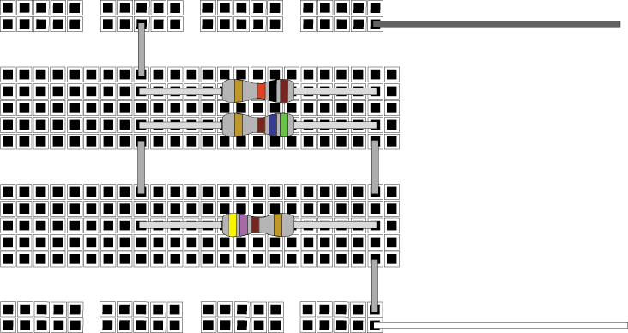
Parallel circuit (with a common mistake)
+
+
470 Ω
560 Ω
1 kΩ

Slide 8
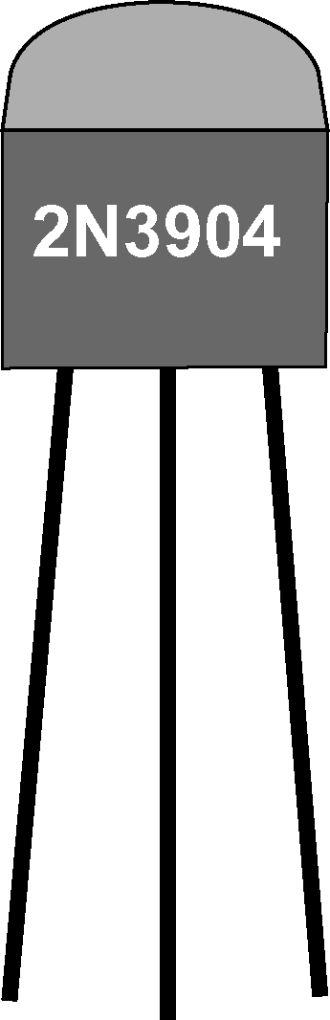




Breadboarding a transistor amplifier
V_{CC}
V_{CC}
Out
.47/63
Out
In
In

Slide 9
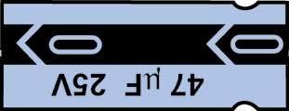
Is this also correct?
V_{CC}
V_{CC}
Out
.47/63
Out
In
In
Previous slide

Slide 10
Double check the pin numbers when working with ICs.
14
8
1
7

Slide 11
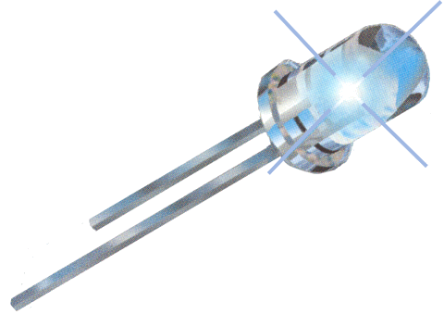

A digital circuit
V_{CC}
V_{CC}
C
A
A
Observe
polarity!
C
Current limit
Pull-up

Slide 12
General guidelines:
Do not force wires larger than #20 gage. Add soldered extensions using #22 solid wire.
Use an IC removal tool or use a screwdriver to carefully pry up ICs for removal.
Use buses for power and ground distribution.
Add bypass capacitors to power buses.
Check and recheck before applying power.
Cut off ends and re-strip jumpers when they are worn.
Do not breadboard high power, high current or high voltage circuits.
RF circuits usually won’t work properly, if at all.
Keep high gain circuits inline and avoid long jumpers.
Adapters are available for SMT devices.

